Slide 1
REPORT ON THE MEDICAL CANNABIS REGULATION AND SAFETY ACT AND THE ADULT USE OF MARIJUANA ACT AND RECOMMENDED ACTIONS
February 28, 2017

Slide 2
It is recommended that the Board of Supervisors:
Receive the report on the Medical Cannabis Regulation and Safety Act and the Adult Use of Marijuana Act.
Direct County Counsel to prepare for consideration by the Board of Supervisors proposed amendments to County Code of Ordinance Title 4, Division 10, Chapter 1: Medical Marijuana (the Cultivation Ban) and Development Title 9, Division 1, Chapter 9-125: Medical Marijuana Dispensary Regulations (the Dispensary Ban) provided in the staff report to update and maintain the existing prohibition on commercial cannabis activity;
Provide direction to staff regarding the new cannabis laws and regulations in the Medical Cannabis Regulation Safety Act and the Adult Use of Marijuana Act.

Slide 3
History of County Cannabis Regulations
DISPENSARY BAN: August 9, 2011, the Board adopted County Ordinance Code, Title 9, Division 1, Chapter 9-125: Medical Marijuana Dispensary Regulations prohibiting medical marijuana dispensaries in San Joaquin County.
  Ordinance Section 9-125.2 defines a medical marijuana dispensary as “any facility where medical marijuana is made available pursuant to Health and Safety Code Sections 11362.5 (The Compassionate Use Act of 1996) and Sections 11362.7 through 11362.83 (Medical Marijuana Program).”

Slide 4
History of County Cannabis Regulations
CULTIVATION BAN: On April 14, 2015, the Board adopted County Code of Ordinance Title 4, Division 10, Chapter 1: Medical Marijuana prohibiting all (indoor and outdoor) medical marijuana cultivation.
  Title 4, Division 10, Chapter 1 defines Medical Marijuana Cultivation as “the planting, growing, harvesting, drying, processing, or storage of one or more marijuana plants or any part thereof, for medicinal purposes in accordance with California Health and Safety Code Sections 11362.7 et seq. as it now reads or as amended.”

Slide 5
NEW STATE LAWS RE CANNABIS
2015: MEDICAL MARIJUANA REGULATION & SAFETY ACT (MMRSA)
  AB 243, AB 266, SB 643
  Amended to Medical Cannabis Regulation & Safety Act (MCRSA)
  Medical Cannabis licensing
2016: ADULT USE OF MARIJUANA ACT (AUMA)
  Voter Approved Prop 64
  Adult Use (over 21) licensing that substantially mirrors MCRSA

Slide 6
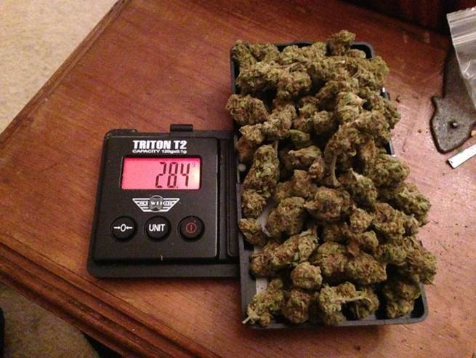
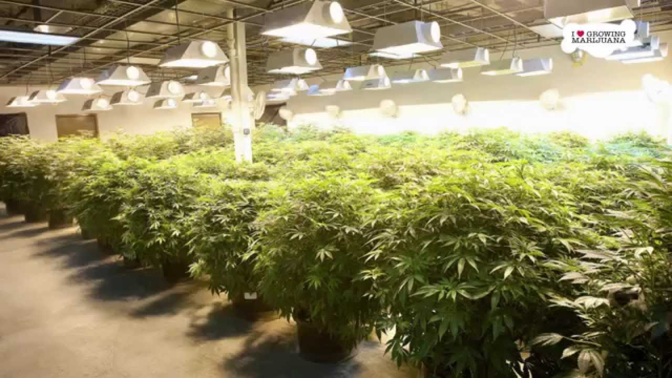
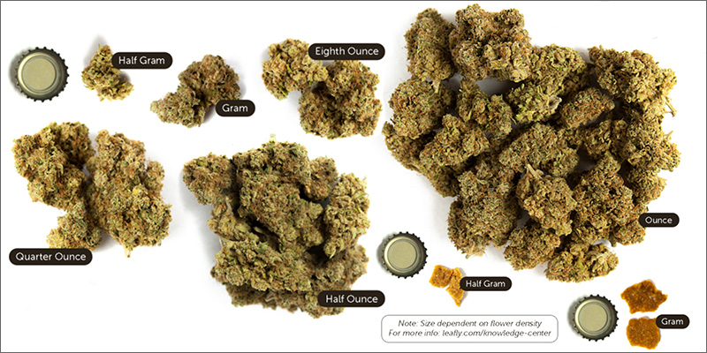
AUMA’s Legalization of Adult Use Cannabis
Persons 21 years of age or older can legally:
Possess etc. 28.5 grams of cannabis;
Possess etc. 8 grams of concentrated cannabis;
Possess etc. 6 plants and the cannabis produced by the plants; and
Smoke or ingest cannabis.

Slide 7
Preemption of County Code by AUMA
AUMA added Health and Safety Code §§ 11362.1-2.
Section 11362.1 makes it legal to “[p]ossess, plant, cultivate, harvest, dry, or process not more than six living marijuana plants and possess the marijuana produced by the plants.”
Section 11362.2 states that no county may prohibit such possession and cultivation if it is “inside a private residence, or inside an accessory structure to a private residence…that is fully enclosed and secure.”
A “private residence” means a “house, an apartment unit, a mobile home, or other similar dwelling.”

Slide 8
Comparison of MCRSA and AUMA
MCRSA licenses/regulates commercial medical cannabis activities.
MCRSA established 17 license types.
All licenses require state AND local approval.
AUMA legalized adult use of recreational cannabis and created a separate regulatory/license structure adult use cannabis that significantly mirrors MCRSA.
AUMA established 19 license types.
All licenses require state AND local approval.

Slide 9
Comparison of MCRSA and AUMA Cont.
MCRSA prohibits vertical integration.
MCRSA does not create any new taxes.
  Allows local municipalities to tax medical cannabis activity.
MCRSA establishes a Medical Cannabis Regulation and Safety Act Fund.
AUMA allows vertical integration.
AUMA does create new state taxes on medical and adult use cannabis (estimated to be near 35%.)
  AUMA also allows local municipalities to tax cannabis activity.
AUMA establishes a new California Marijuana Tax Fund.

Slide 10
Comparison of MCRSA and AUMA Cont.
MCRSA allows local jurisdictions adopt and enforce ordinances that ban, restrict, or reasonably regulate the commercial cannabis activities identified in MCRSA.
AUMA allows local jurisdictions to adopt and enforce ordinances that ban, restrict, or reasonably regulate cannabis activities identified in AUMA, except they cannot completely ban cultivation of up to six plants for adult use as detailed in Health and Safety Code § 11362.2.

Slide 11
Proposed Amendments
Amendments to the Dispensary Ban will:
  Change the title from Medical Marijuana Dispensary Regulations to Cannabis Dispensary Regulations
  Expand the language to prohibit any transfer of cannabis and any activity defined as “Delivery,” “Distribution” or “Sale under AUMA.
Amendments to Cultivation Ban will:
  Change the title from Medical Marijuana to Cannabis
  Update the findings to address the health and safety concerns through 2016.
  Expand the language to prohibit commercial cannabis activity as defined in MCRSA or AUMA, except as possession of medical marijuana by patients or primary caregivers.
Collectively the proposed amendments will maintain the current status quo and allow only possession of medical cannabis by patients and caregivers and possession and cultivation of adult use of cannabis at a personal residence (pursuant to H&S 11362.2(b)(2))

Slide 12
It is recommended that the Board of Supervisors:
Receive the report on the Medical Cannabis Regulation and Safety Act and the Adult Use of Marijuana Act.
Direct County Counsel to prepare for consideration by the Board of Supervisors proposed amendments to County Code of Ordinance Title 4, Division 10, Chapter 1: Medical Marijuana and Development Title 9, Division 1, Chapter 9-125: Medical Marijuana Dispensary Regulations provided herein to update and maintain the existing prohibition on commercial cannabis activity;
Provide direction to staff regarding the new cannabis laws and regulations in the Medical Cannabis Regulation Safety Act and the Adult Use of Marijuana Act.

